Slide 1
Correlation and Covariance
Source Reference: www.eng.utah.edu › lec_Notes › Corr_Cov › Corr_Cov

Slide 2
Goals
Introduce concepts of
  Covariance
  Correlation
Develop computational formulas
Source Reference: www.eng.utah.edu › lec_Notes › Corr_Cov › Corr_Cov

Slide 3
Covariance
Variables may change in relation to each other
Covariance measures how much the movement in one variable predicts the movement in a corresponding variable
Source Reference: www.eng.utah.edu › lec_Notes › Corr_Cov › Corr_Cov

Slide 4
Smoking and Lung Capacity
Example: investigate relationship between cigarette smoking and lung capacity
Data: sample group response data on smoking habits, and measured lung capacities, respectively
Source Reference: www.eng.utah.edu › lec_Notes › Corr_Cov › Corr_Cov

Slide 5
Smoking v Lung Capacity Data
N | Cigarettes (X ) | Lung Capacity (Y )
1 | 0 | 45
2 | 5 | 42
3 | 10 | 33
4 | 15 | 31
5 | 20 | 29
Source Reference: www.eng.utah.edu › lec_Notes › Corr_Cov › Corr_Cov

Slide 6
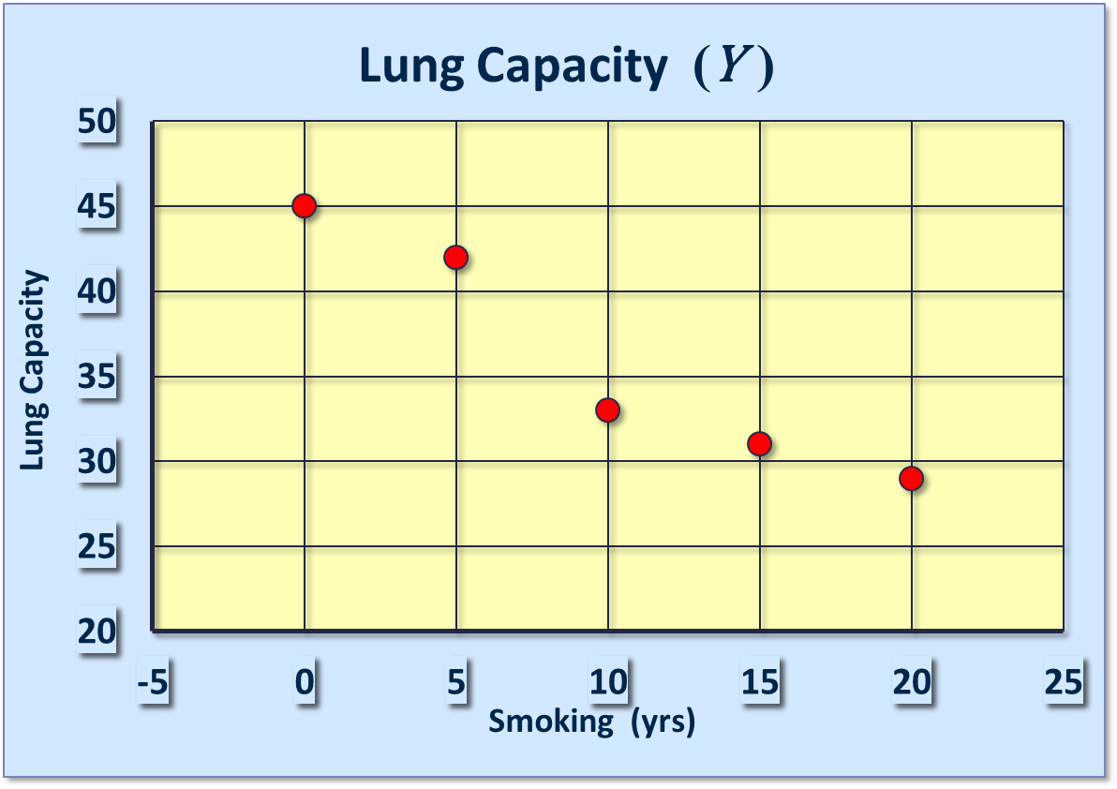
Smoking and Lung Capacity
Source Reference: www.eng.utah.edu › lec_Notes › Corr_Cov › Corr_Cov

Slide 7
Smoking v Lung Capacity
Observe that as smoking exposure goes up, corresponding lung capacity goes down
Variables covary inversely
Covariance and Correlation quantify relationship
Source Reference: www.eng.utah.edu › lec_Notes › Corr_Cov › Corr_Cov

Slide 8
Covariance
Variables that covary inversely, like smoking and lung capacity, tend to appear on opposite sides of the group means
  When smoking is above its group mean, lung capacity tends to be below its group mean.
Average product of deviation measures extent to which variables covary, the degree of linkage between them
Source Reference: www.eng.utah.edu › lec_Notes › Corr_Cov › Corr_Cov

Slide 9
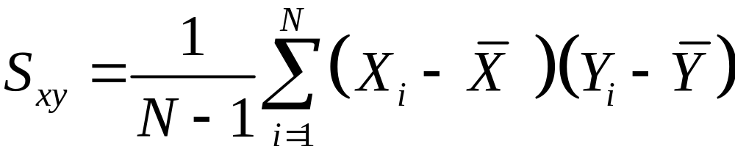
The Sample Covariance
Similar to variance, for theoretical reasons, average is typically computed using (N -1), not N . Thus,
Source Reference: www.eng.utah.edu › lec_Notes › Corr_Cov › Corr_Cov

Slide 10


Calculating Covariance
Cigs (X ) | Lung Cap (Y )
0 | 45
5 | 42
10 | 33
15 | 31
20 | 29
10 | 36
Source Reference: www.eng.utah.edu › lec_Notes › Corr_Cov › Corr_Cov

Slide 11
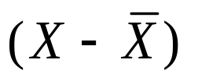
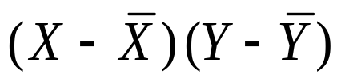
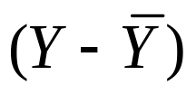
Calculating Covariance
Cigs (X ) |  |  |  | Cap (Y )
0 | -10 | -90 | 9 | 45
5 | -5 | -30 | 6 | 42
10 | 0 | 0 | -3 | 33
15 | 5 | -25 | -5 | 31
20 | 10 | -70 | -7 | 29
 |  | ∑= -215
Source Reference: www.eng.utah.edu › lec_Notes › Corr_Cov › Corr_Cov

Slide 12
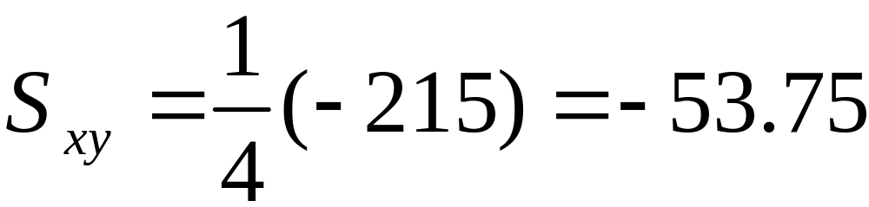
Covariance Calculation | (2)
Evaluation yields,
Source Reference: www.eng.utah.edu › lec_Notes › Corr_Cov › Corr_Cov

Slide 13
Variance vs Covariance
First, a note on your sample:
    If you’re wishing to assume that your sample is representative of the general population (RANDOM EFFECTS MODEL), use the degrees of freedom (n – 1) in your calculations of variance or covariance.
    But if you’re simply wanting to assess your current sample (FIXED EFFECTS MODEL), substitute n for the degrees of freedom.
Source Reference: https://www.fil.ion.ucl.ac.uk › spm › doc › mfd › Corr-and-Regress

Slide 14
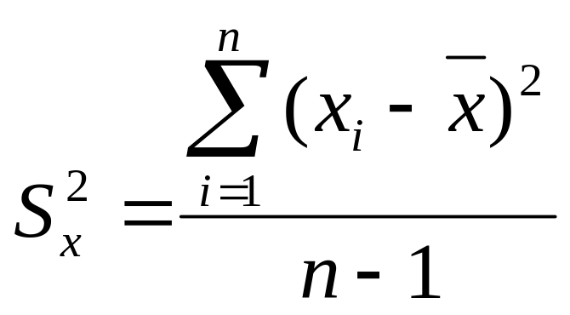
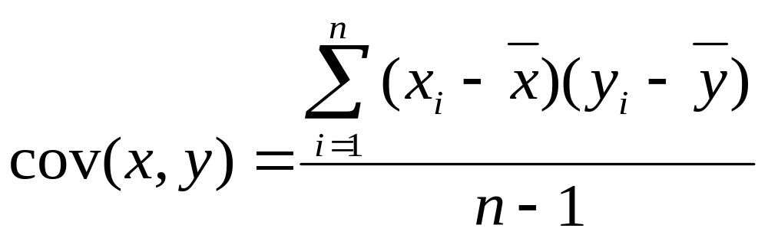
Variance vs Covariance
Do two variables change together?
Variance:
Gives information on variability of a single variable.
Covariance:
Gives information on the degree to which two variables vary together.
Note how similar the covariance is to variance: the equation simply multiplies x’s error scores by y’s error scores as opposed to squaring x’s error scores.
Reference: https://www.fil.ion.ucl.ac.uk › spm › doc › mfd › Corr-and-Regress

Slide 15
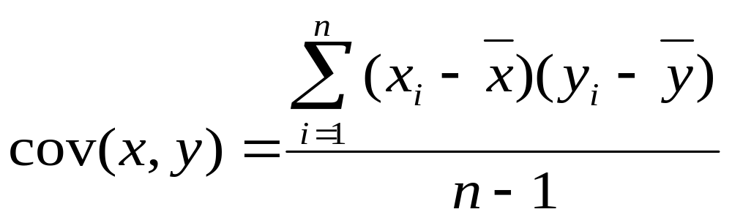
Covariance
When X and Y : cov (x,y) = pos.
When X and Y : cov (x,y) = neg.
When no constant relationship: cov (x,y) = 0
Reference: https://www.fil.ion.ucl.ac.uk › spm › doc › mfd › Corr-and-Regress

Slide 16
Problem with Covariance:
The value obtained by covariance is dependent on the size of the data’s standard deviations: if large, the value will be greater than if small… even if the relationship between x and y is exactly the same in the large versus small standard deviation datasets.
Reference: https://www.fil.ion.ucl.ac.uk › spm › doc › mfd › Corr-and-Regress

Slide 17
Example of how covariance value relies on variance
 | High variance data |  |  |  | Low variance data
Subject | x | y | x error * y error |  | x | y | X error * y error
1 | 101 | 100 | 2500 |  | 54 | 53 | 9
2 | 81 | 80 | 900 |  | 53 | 52 | 4
3 | 61 | 60 | 100 |  | 52 | 51 | 1
4 | 51 | 50 | 0 |  | 51 | 50 | 0
5 | 41 | 40 | 100 |  | 50 | 49 | 1
6 | 21 | 20 | 900 |  | 49 | 48 | 4
7 | 1 | 0 | 2500 |  | 48 | 47 | 9
Mean | 51 | 50 |  |  | 51 | 50
Sum of x error * y error : |  |  | 7000 |  | Sum of x error * y error : |  | 28
Covariance: |  |  | 1166.67 |  | Covariance: |  | 4.67
Reference: https://www.fil.ion.ucl.ac.uk › spm › doc › mfd › Corr-and-Regress

Slide 18
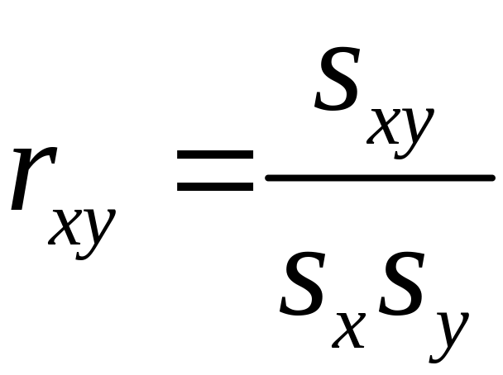
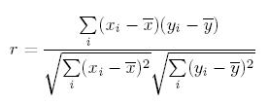
(Pearson) Correlation Coefficient r_{xy}
Source Reference: www.eng.utah.edu › lec_Notes › Corr_Cov › Corr_Cov

Slide 19
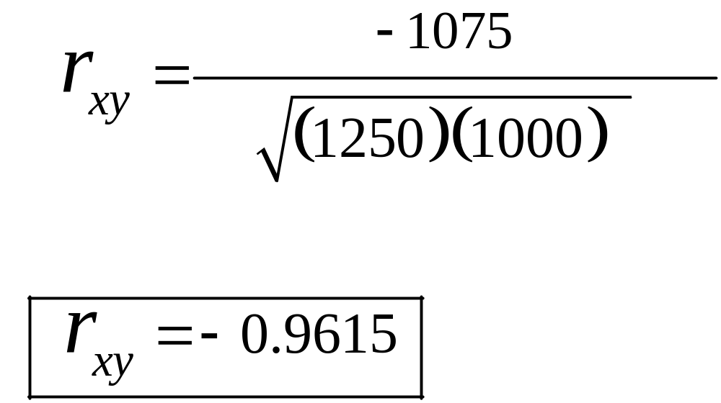
Computing Correlation
Source Reference: www.eng.utah.edu › lec_Notes › Corr_Cov › Corr_Cov

Slide 20
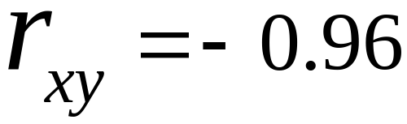
Conclusion
r_{xy} = -0.96 implies almost certainty smoker will have diminish lung capacity
Greater smoking exposure implies greater likelihood of lung damage
Source Reference: www.eng.utah.edu › lec_Notes › Corr_Cov › Corr_Cov

